Slide 1
The weaker sex? Public services, gender and employment rights
Dr Lydia Hayes
Cardiff University
School of Law

Slide 2
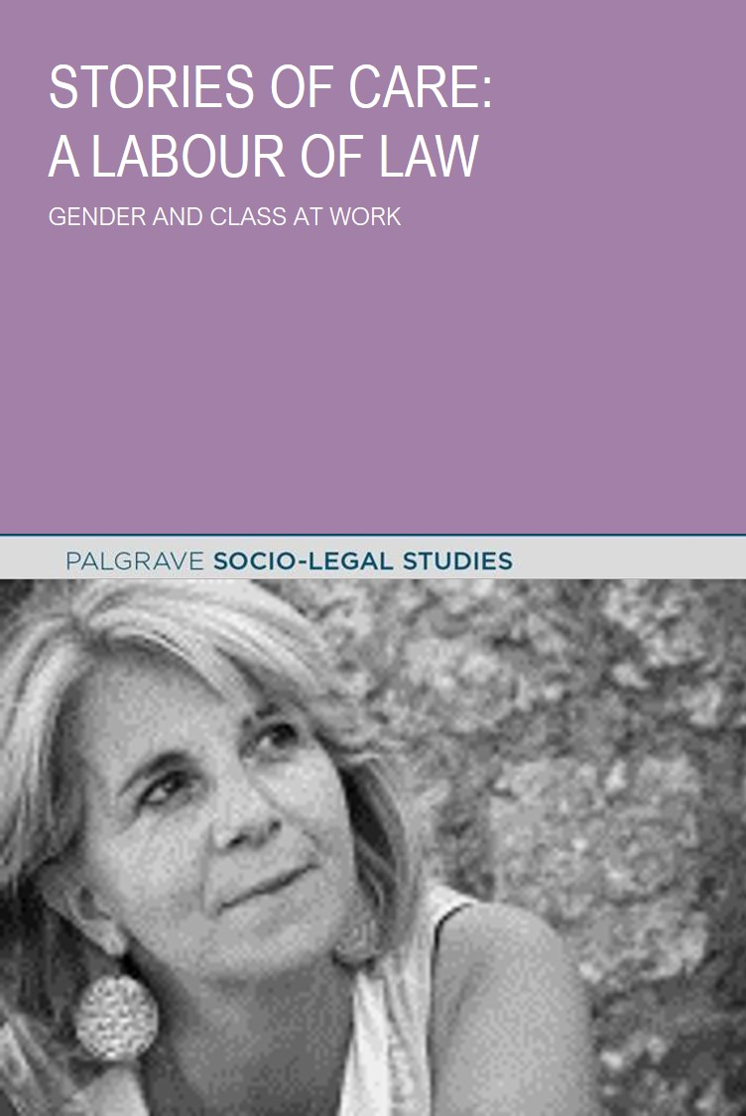
LJB Hayes
Palgrave McMillan
Jan 2017

Slide 3
The Weaker Sex?
Exploring employment rights from perspective of homecare workers is important for understanding the impact of law
The relationship between privatisation of public services and employment rights is highly instructive for understanding the role of the state
Despite tribunal fees and other barriers – law has a normative relevance in shaping expectations. Legal standards matter.
Law communicates sexist assumptions about women in work – cannot be addressed by pulling women worker ‘back’ into law, need to change law.
Law has ‘baggage’ about differences between men and women in paid employment

Slide 4
context – abusive employment
Crisis in the regulation of employment of care workers
3 out of 10 homecare workers leave their job every year (highest in UK)
Employers admit to employing half on insecure zero-hours contracts (although likely higher)
Half of new starters leave within twelve months
42% of homecare workers have less than a year’s service
Hundreds of thousands of social care workers are paid less than National Minimum Wage

Slide 5
context – abusive employment
Crisis in the regulation of employment of care workers
The social care sector is the UK’s BIGGEST low wage employer of women
Between 2009 – 2014 homecare jobs increased by 35%
Between 2010 – 2014, in real terms, pay fell by 6%
2013/2014 pay – local authority £10.61 – living wage £7.65 - advertised pay - £7.36 – minimum wage £6.50
Largest growth in self-employment amongst women is as homecare workers.

Slide 6
context – abusive environment
Crisis in the regulation of employment of care workers
Dept of Health (2013) social care workers especially vulnerable – violence, assault, verbal abuse – due to ‘particular lack of respect’
Widespread industry disregard, part of the job
Ignores organisational context
Studies show causation linked to professional status, poor management, being female.

Slide 7
context – abusive environment
Crisis in the regulation of employment of care workers
Formal referrals about elder abuse are increasing (55,100 investigated 2012/13)
Most likely reported source of harm is care workers 34% (more than family 23%)
3 in 4 are residential care workers
Homecare workers most likely to steal
Gendered - Women most at risk as victims, perpetrator women non-physical, male physical
Risk factors – low level staffing, routine temporary staff, lack of training, poor supervision, high staff turnover, weak management.

Slide 8
Where do the problems lie?
Contracts of Employment Act 1963
Unfair Dismissal
‘trying to ensure that men are treated like human beings, that they are given proper notice and that they are not put out on the street at a minute’s or an hour’s notice’(Hansard, c.1113, 1st May 1963).
Only extended to people working for 21 hours a week or more to exclude ‘women with domestic responsibilities [to whom] the employment relationship is not of substantial importance’.
Sex-based hierarchy in labour market.
The routine exclusion of women from the benefit of employment protection rights until the UK responded to pressure from the European Union in the mid-1990s.
Time limitations – what is the purpose?
42% homecare workers in post under 12 months
Two-tier employment status – statute ‘worker’ reflects status of women. Zero hours contacts, most women.

Slide 9
Where do the problems lie?
Equal Pay Law
National Minimum Wage Law
Failed to address undervaluing of low wage ‘women’s work’
Only remedy is for work in the presence of a man
Privatisation is able to sever collective bargaining links
‘Independent sector’ ??
Ability of state to impose wages at a discriminatory level is a fundamental problem
Support for unpaid work: Walton v Independent Living Association [2003] CA Civ 99 (unmeasured work not time work)
Questions if care work is ‘work’ South Holland v Stamp
Familial exemption Nambalat v Tayer [2012] EWCA Civ 1249 (paying family members with direct payments money now legally permissable)
Al-Malki v Reyes [2015] EWCA Civ 32
Fits badly with increased control requirements in Care Act 2014. LJB Hayes (2015) Care and Control, Industrial Law Journal (2015)
Residential Care cases with standard and call-out contracts for residential workers (Edinburgh Council v Lauder) – subject to higher standards than security guards (Scottbridge)

Slide 10
Institutionalised Humiliation
Of care workers?
Of other low waged workers?
Background conditions to their experience of work – collective, NOT indivdual – defined as an inferior group through the law.
Persistent judgments of inferiority – judges, politicians, government, media, employers
‘Being Humiliated’ – actions of another party
Changed relation to other, loss of status, offends notions of social justice ie equality, fair treatment
Invokes feelings of powerlessness (half way shame and anger)

